Slide 1
Common Cartridges by Goodheart-Willcox
Class Information
LMS:
Log into your Institution’s Learning Management System (LMS)
<Insert LMS URL here>

Slide 2
Common Cartridges by Goodheart-Willcox
Class Information
Activation:
Navigate to your course, and select Activate Your Subscription.

Slide 3
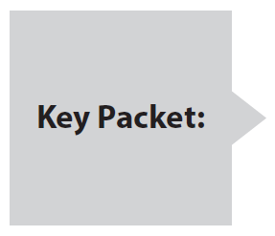
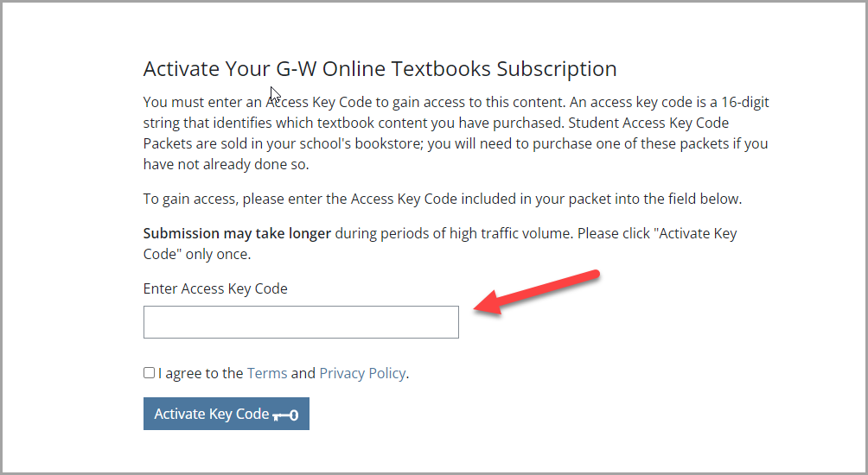
Common Cartridges by Goodheart-Willcox
Class Information
You will need a Key Code to access the online content. The Key Code packet may be bundled with your textbook or purchased separately at your bookstore.
If you have not already purchased your key packet, do so as soon as possible.

Slide 4
Common Cartridges by Goodheart-Willcox
Class Information
Close the browser window containing the key activation confirmation message.
Return to your course.
Refresh your browser to access the content.
Returning to Your Course:

Slide 5
Common Cartridges by Goodheart-Willcox
Class Information
If you have questions or need technical support, please contact G-W Tech Support:
https://support.g-w.com/home/
800.323.0440, M-F, 7:30 a.m. – 5:00 p.m. CST
Technical
Support:

